Slide 1
What next
MOOCs and Tutorial Resources on Deep Learning

Slide 2
Generative Model
Generative models, a branch of unsupervised learning.
Some Algorithms:
Variational Autoencoders
Generative Adversarial Network.

Slide 3

Autoencoders

Slide 4
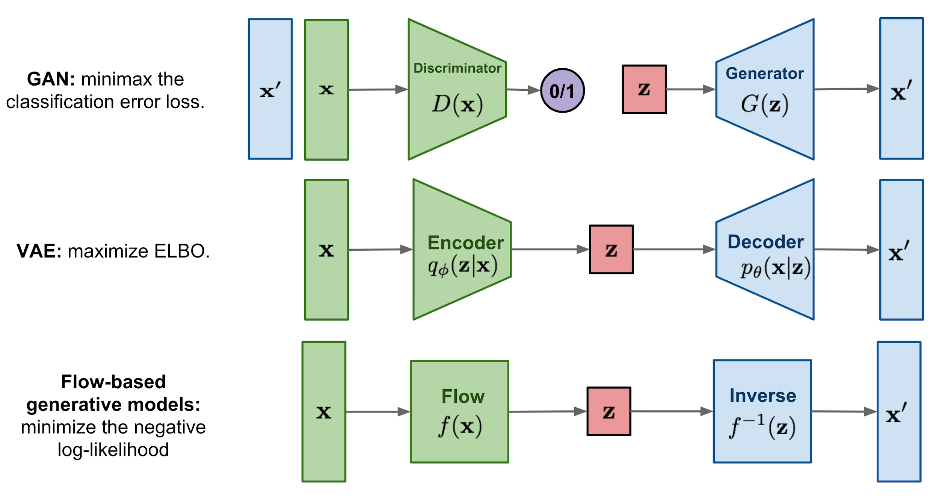
https://lilianweng.github.io/lil-log/2018/10/13/flow-based-deep-generative-models.html

Slide 5
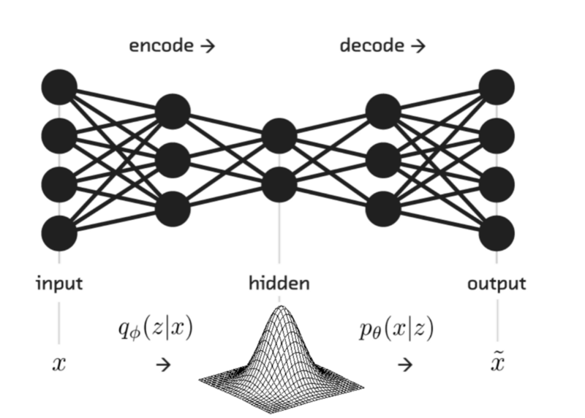
Variational Autoencoders
https://medium.com/@rishabh13/variational-auto-encoders-780c28fd2069

Slide 6
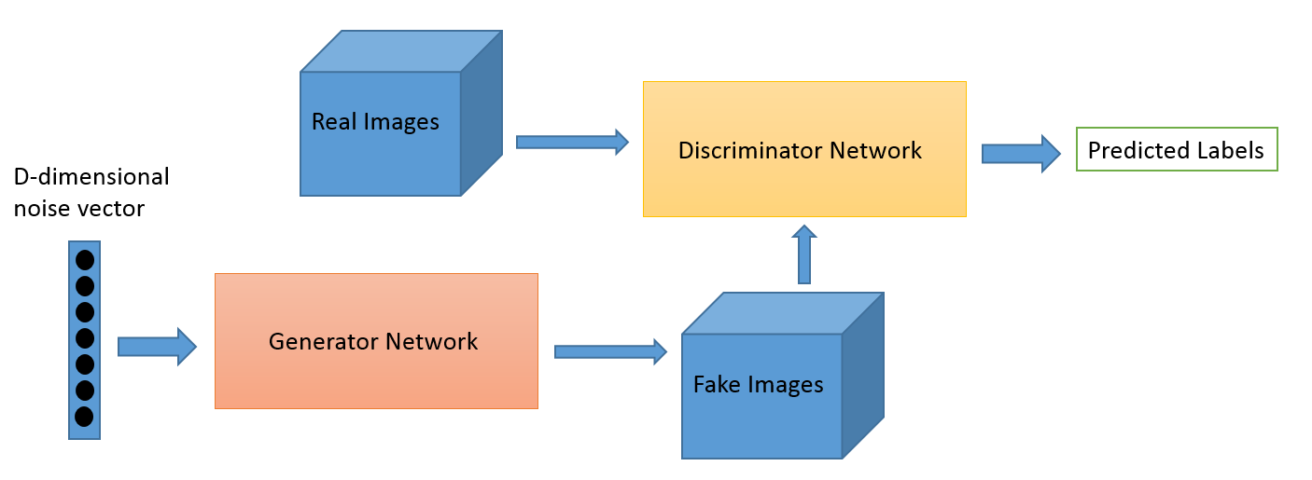
Generative Adversarial Networks: GAN
https://skymind.ai/wiki/generative-adversarial-network-gan

Slide 7
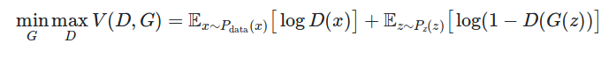
Cost Function of GAN

Slide 8
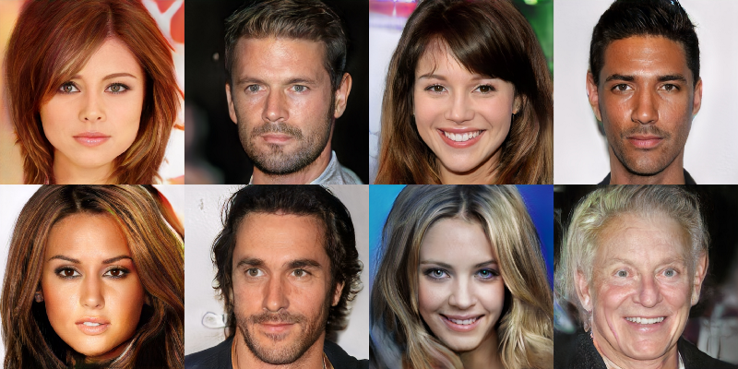
Fake Generated Images
https://medium.com/@kcimc/how-to-recognize-fake-ai-generated-images-4d1f6f9a2842

Slide 9
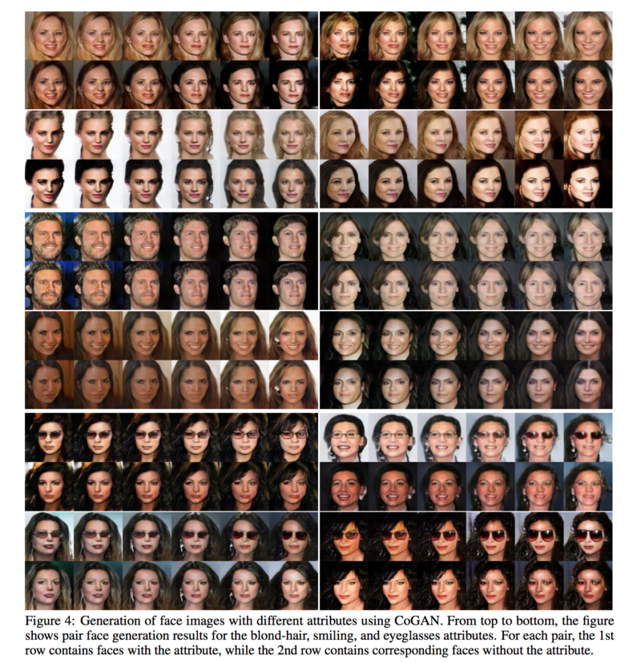
https://medium.com/@jonathan_hui/gan-some-cool-applications-of-gans-4c9ecca35900

Slide 10
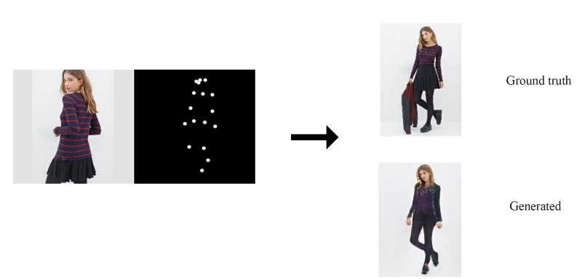
Application
https://medium.com/@jonathan_hui/gan-some-cool-applications-of-gans-4c9ecca35900

Slide 11
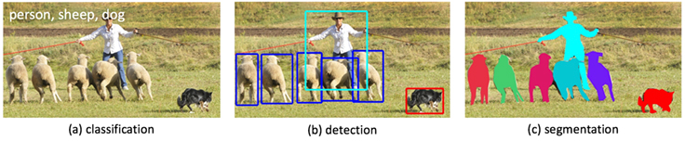
Some common applications in Computer Vision
https://research.fb.com/learning-to-segment/

Slide 12
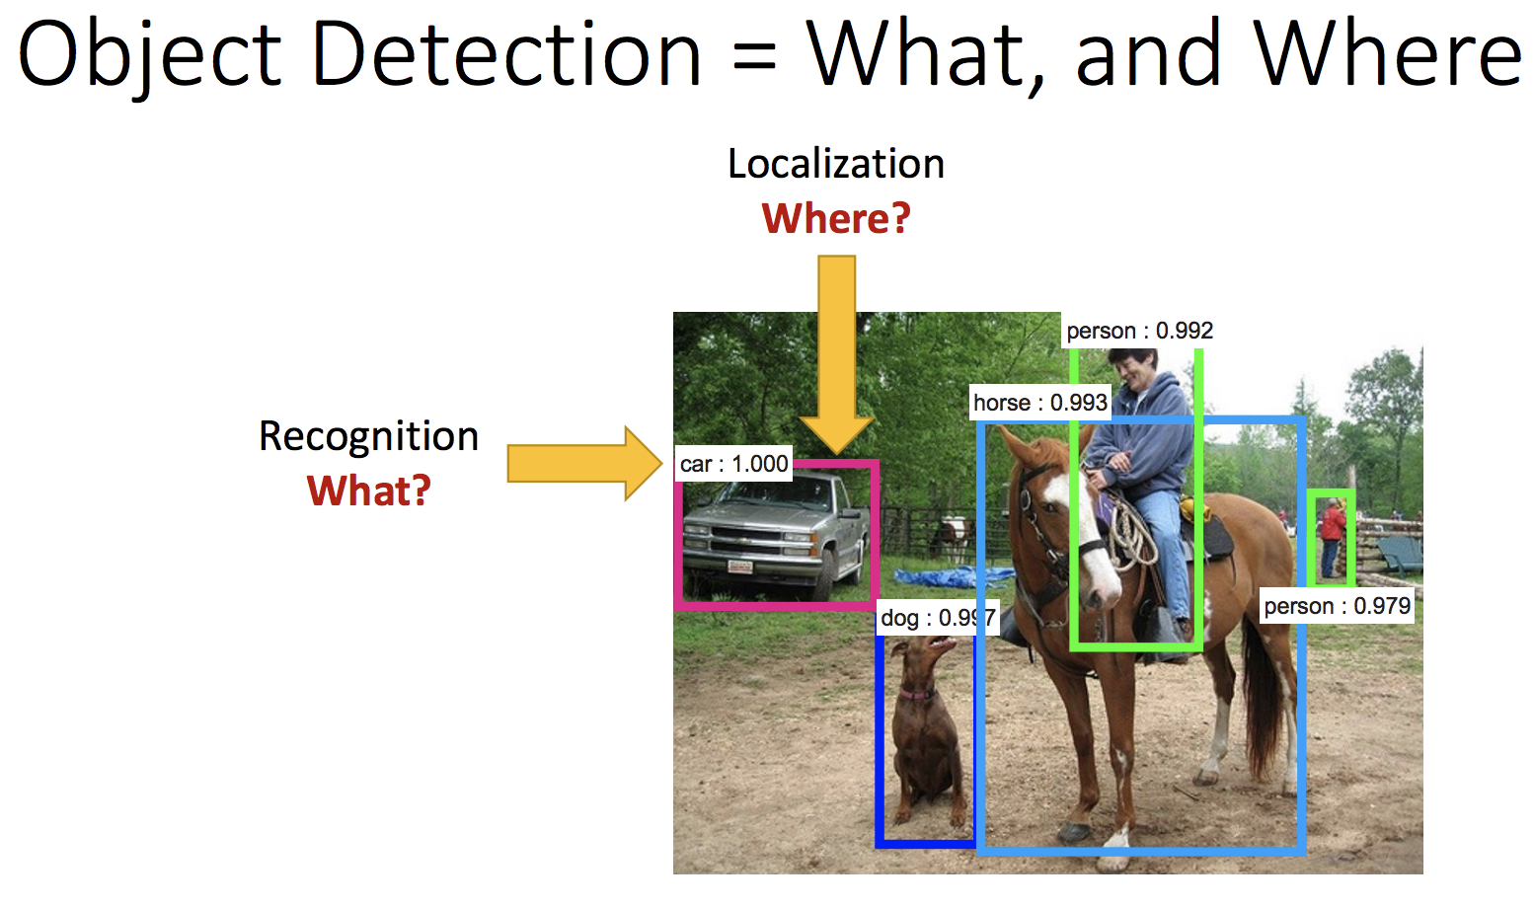

Slide 13
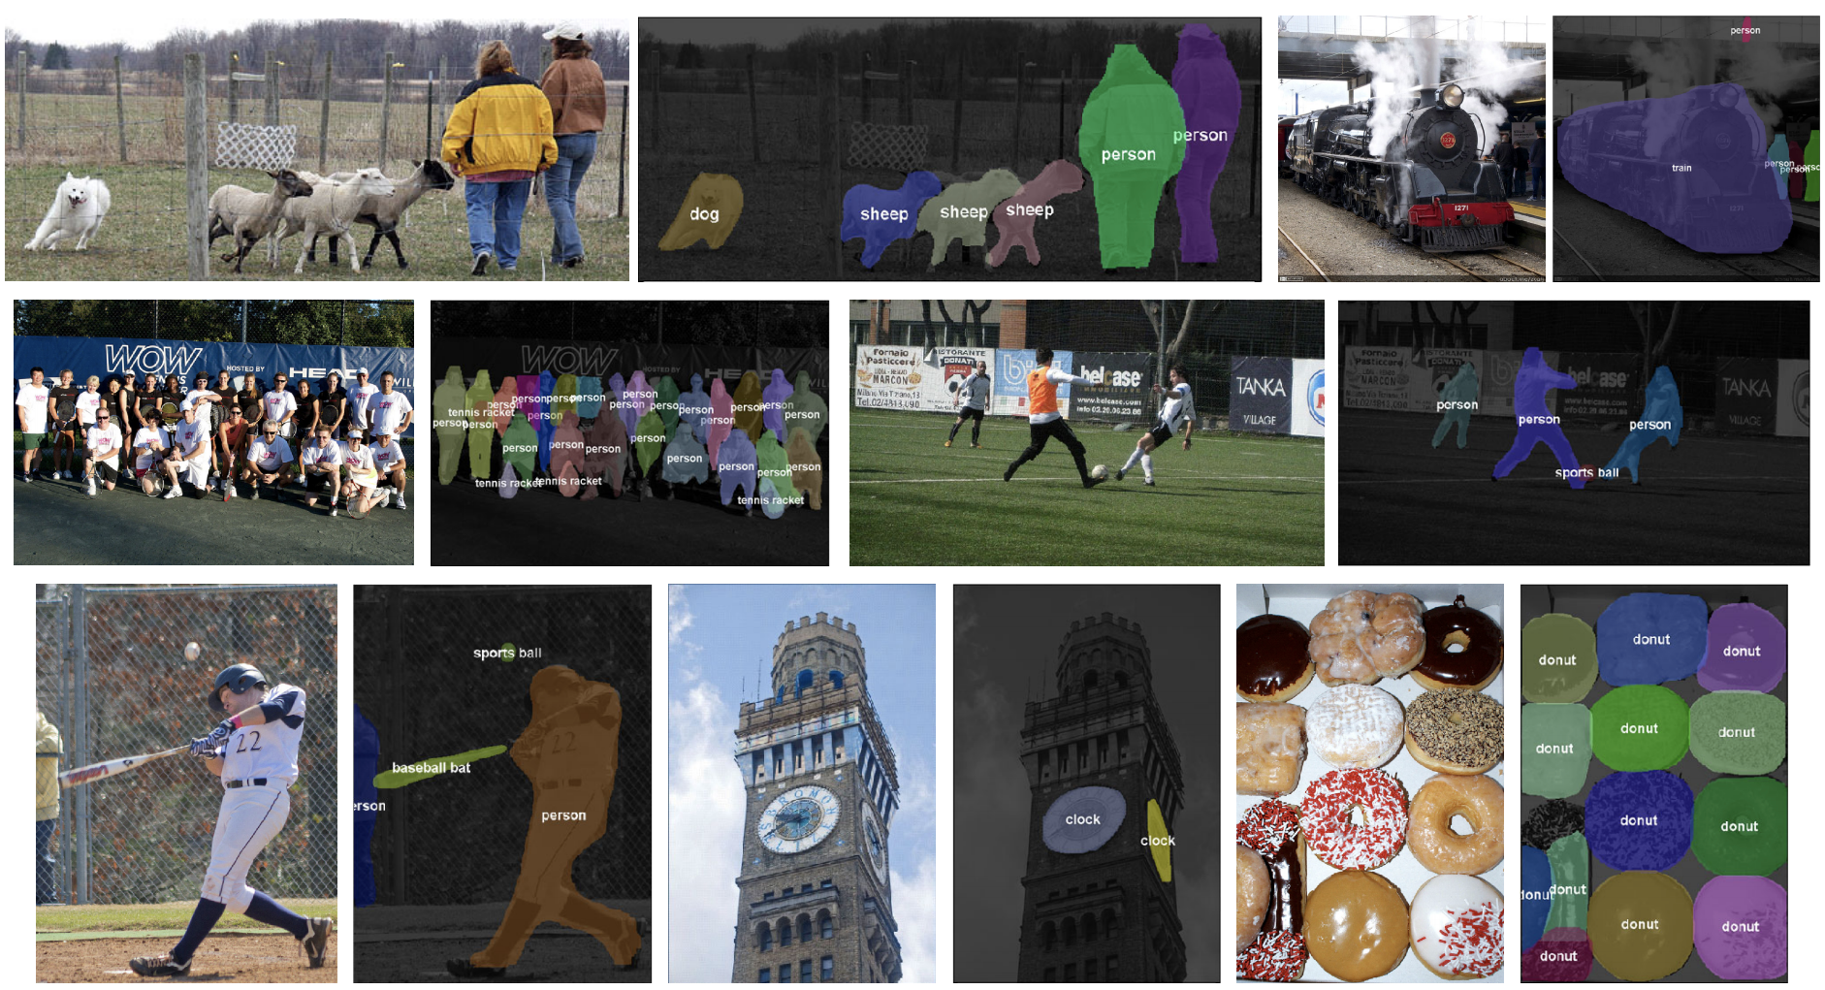
Object Segmentation

Slide 14
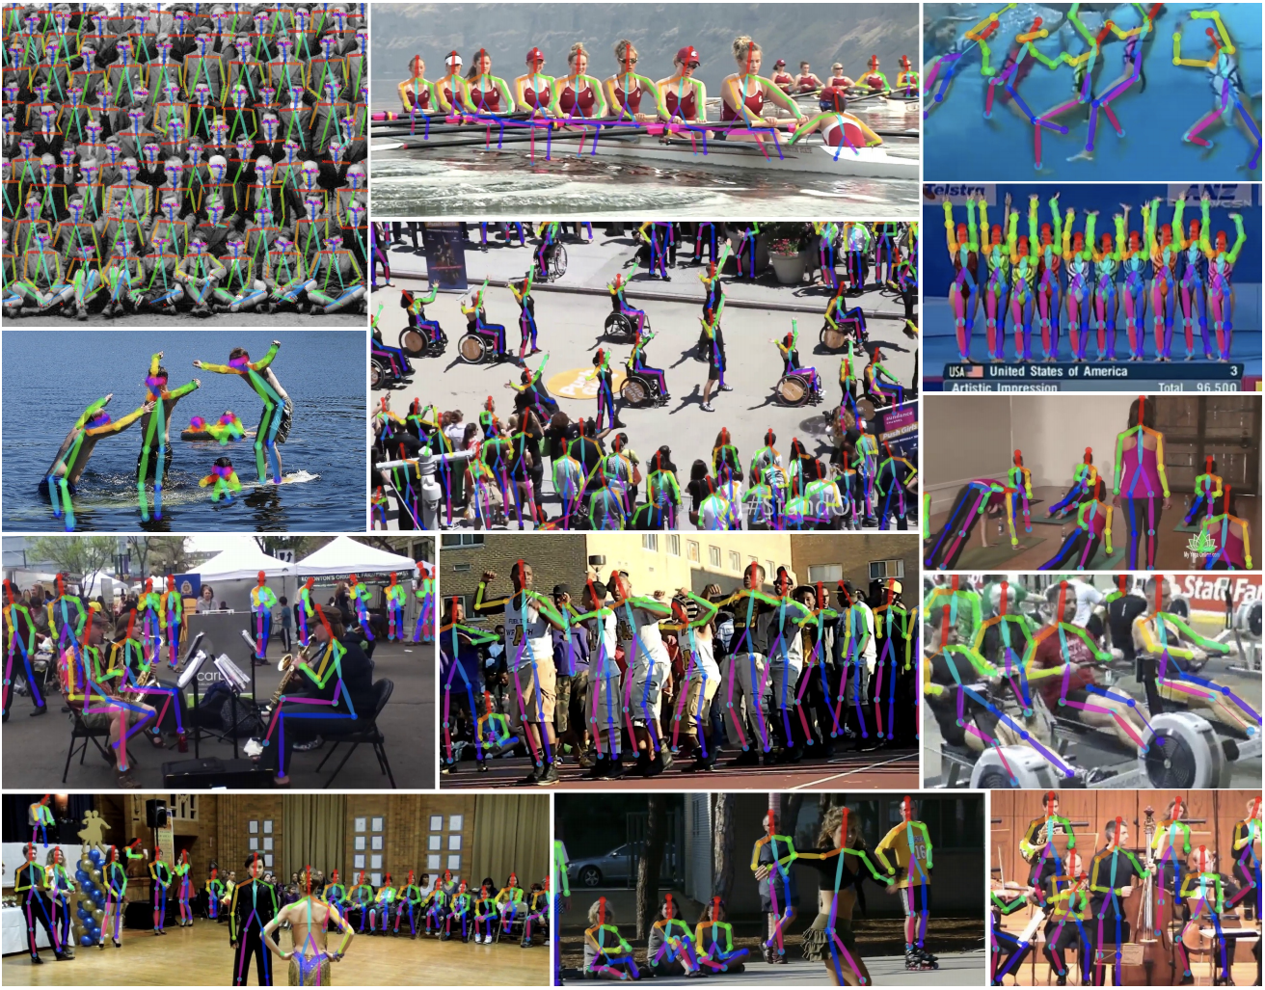
Pose Estimation

Slide 15
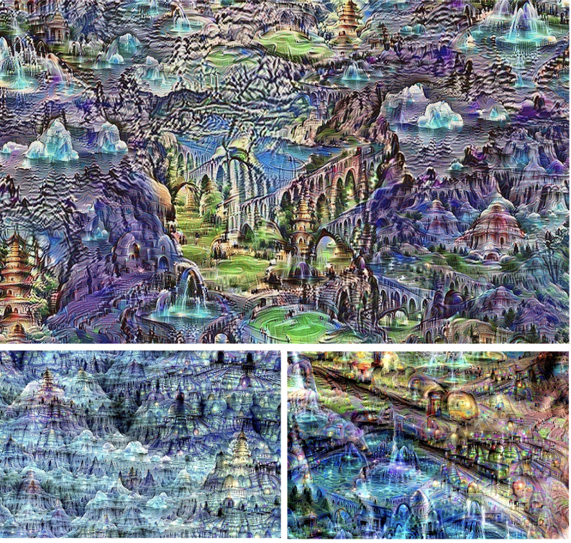
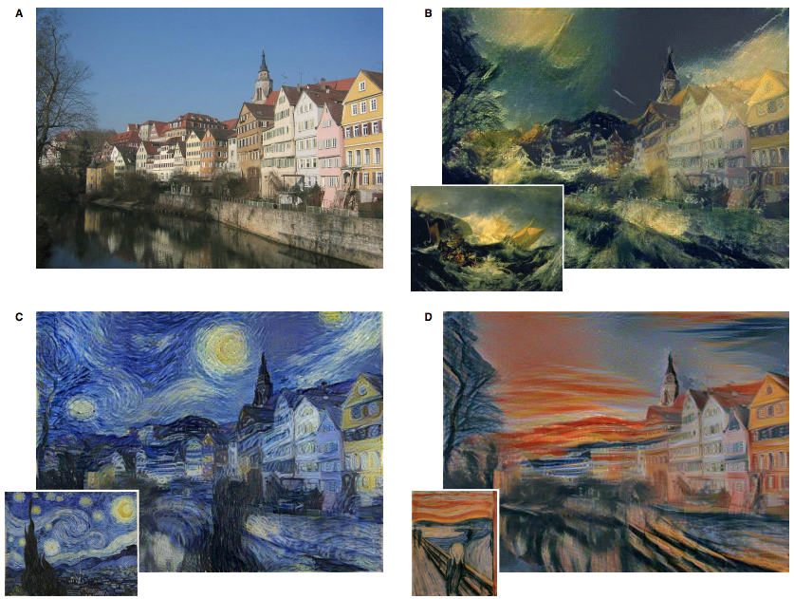
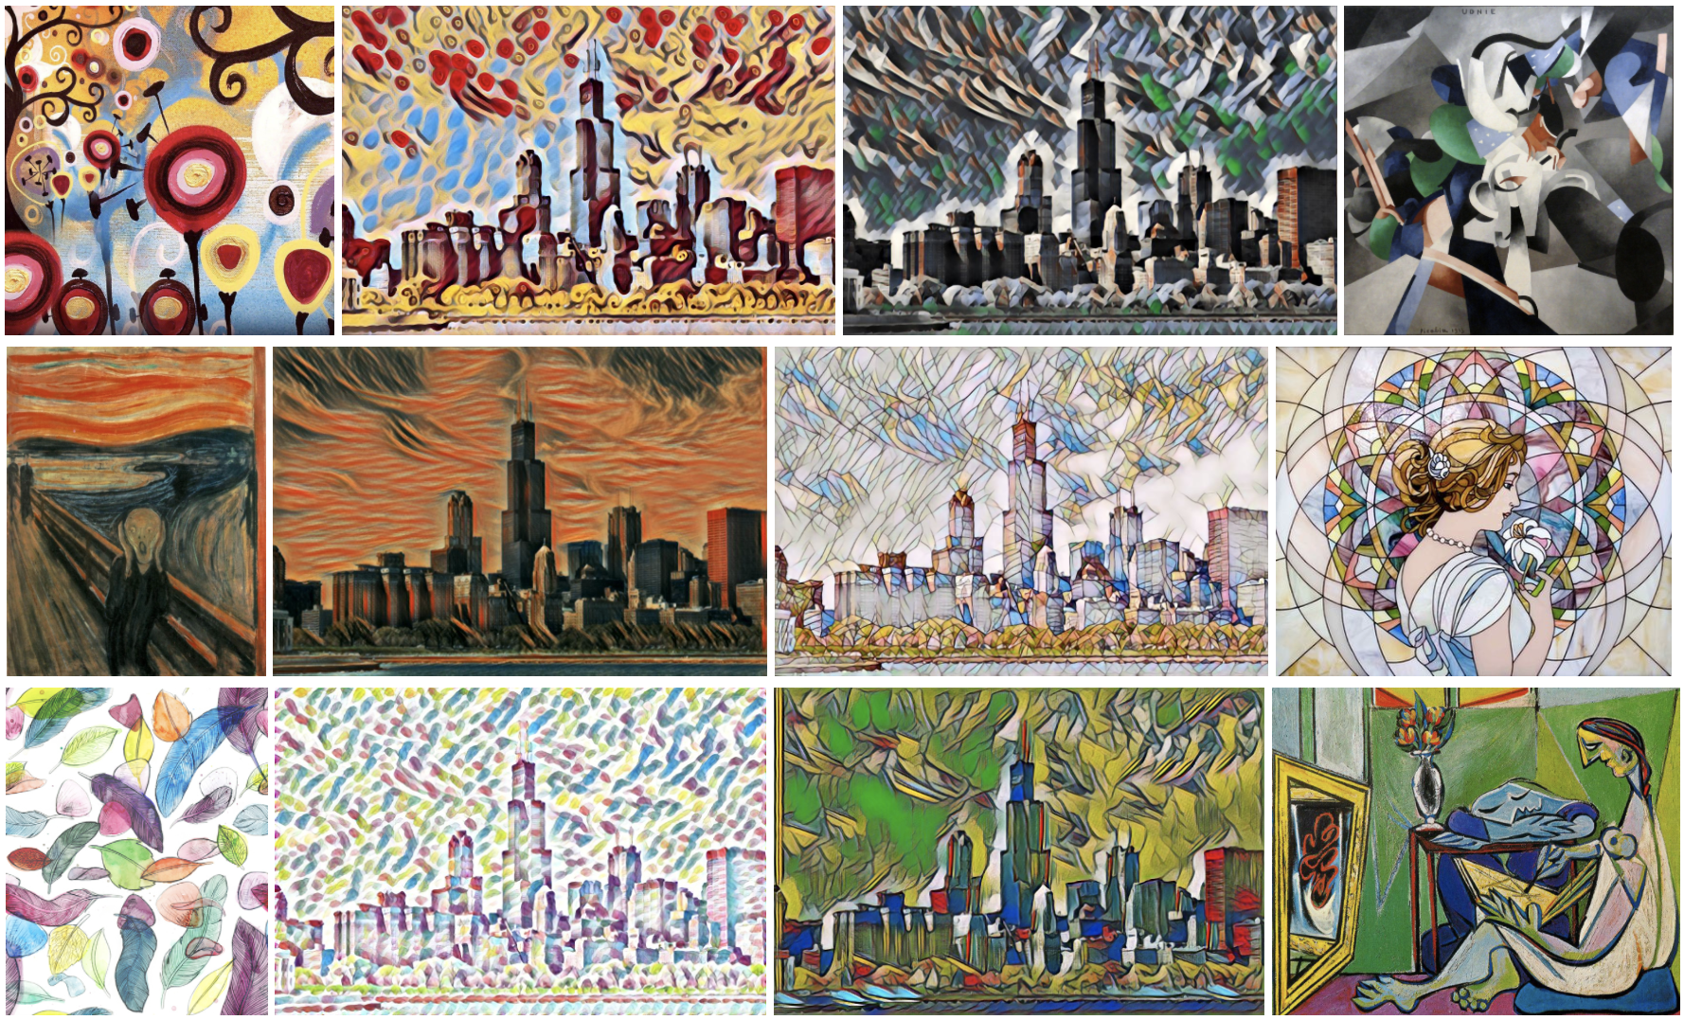
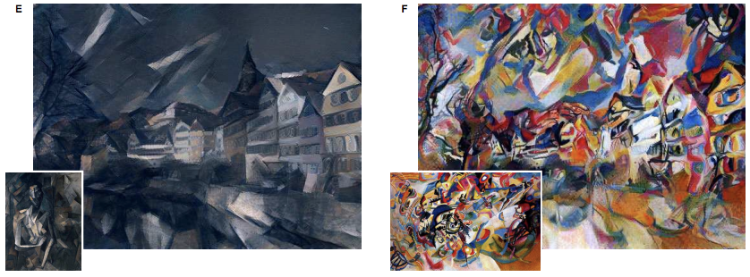
Art generation
Art generation
Gatys, Ecker, and Bethge, “Image Style Transfer using Convolutional Neural Networks”, CVPR 2016 (left)

Slide 16
Others
Image Captioning
Image Super-resolution

Slide 17
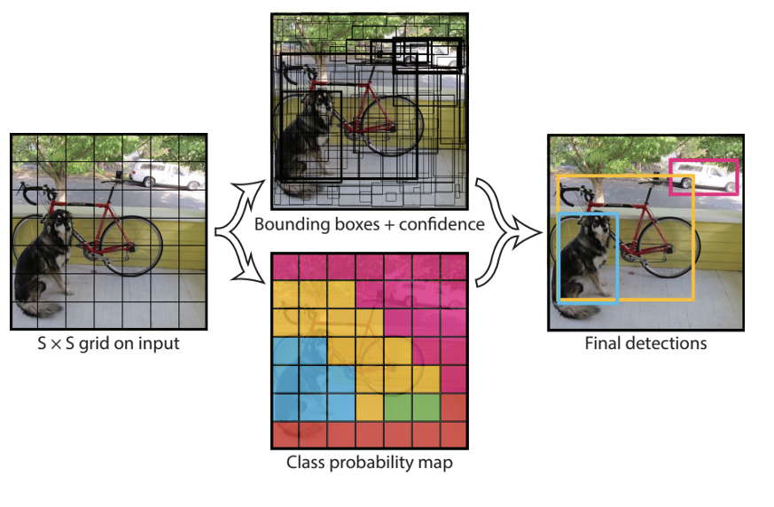
YOLO or You Only Look Once

Slide 18
Other Algorithms for detection and segmentation
SSD
R-CNN
Fast R-CNN

Slide 19
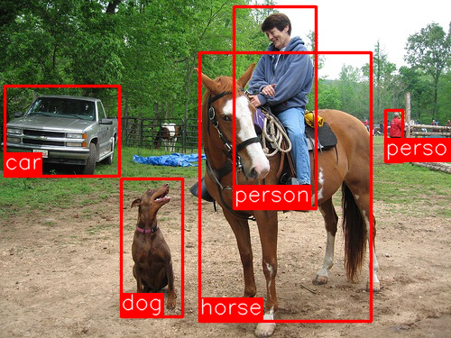
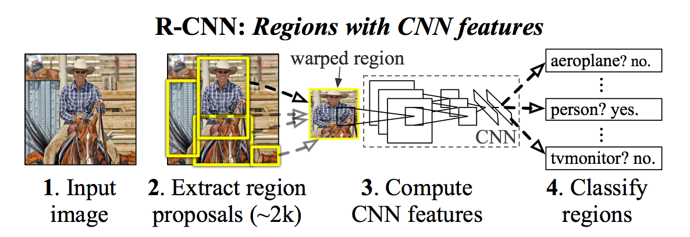
R-CNN :2014
Inputs: Image
Outputs: Bounding boxes + labels for each object in the image

Slide 20
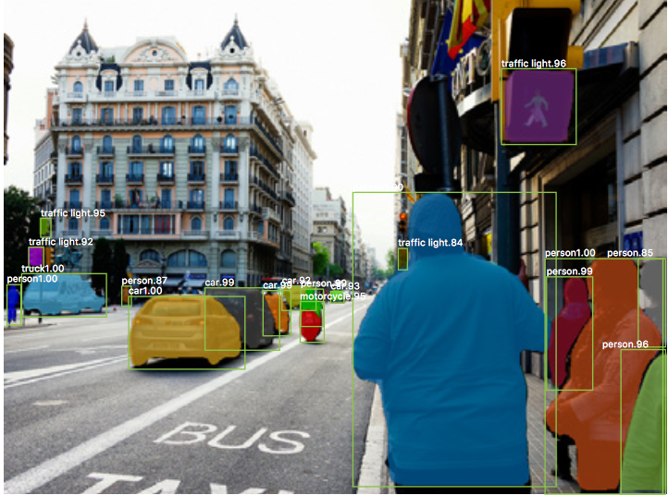
Mask R-CNN - Extending Faster R-CNN for Pixel Level Segmentation : 2017
https://blog.athelas.com/a-brief-history-of-cnns-in-image-segmentation-from-r-cnn-to-mask-r-cnn-34ea83205de4

Slide 21
Reinforcement Learning

Slide 22
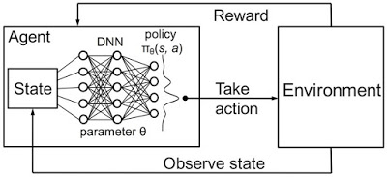
https://pvoodoo.blogspot.com/2017/09/deep-reinforcement-learning-for-trading.html

Slide 23
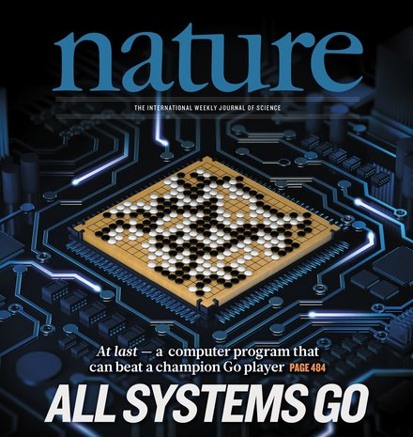


Slide 24
Drawbacks.

Slide 25
Data Hungry.
Computational hungry.
Lacks robustness, easy fooled.
Not enough transparent: No idea about what happening inside the network. Lacks mathematical understanding biological plausibility.
Fairness and ethics: Predicting criminal by faces, Who will be convicted when autonomous car causes accident. ?
Limited methods in unsupervised learning.
Reinforcement Learning are computationally expensive.

Slide 26

Fooling Neural Network
https://blog.openai.com/adversarial-example-research/

Slide 27
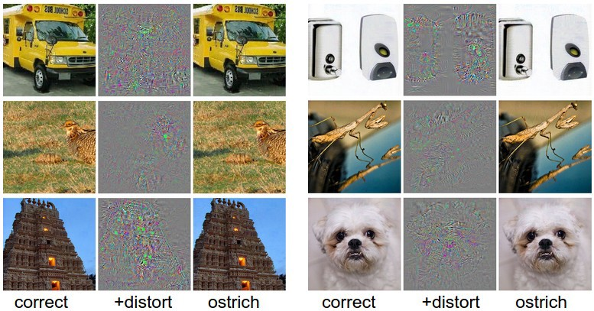
https://medium.com/deep-dimension/deep-learning-papers-review-universal-adversarial-patch-a5ad222a62d2

Slide 28
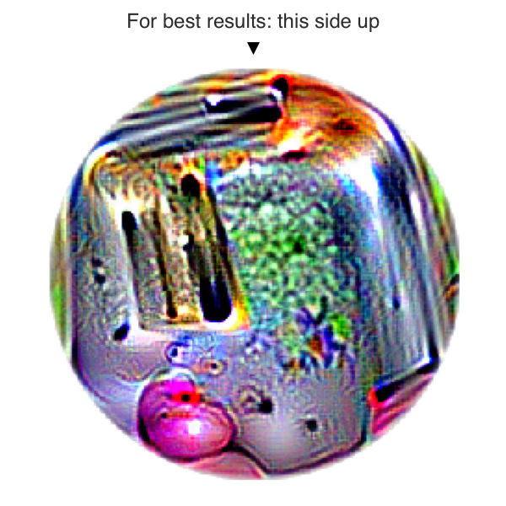
Adversarial Patch

Slide 29
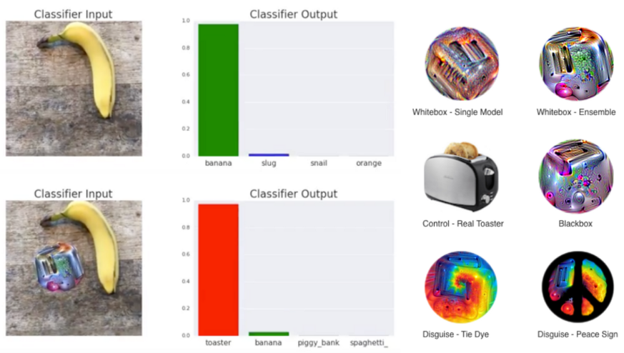
https://arxiv.org/abs/1712.09665

Slide 30
Resources Online

Slide 31
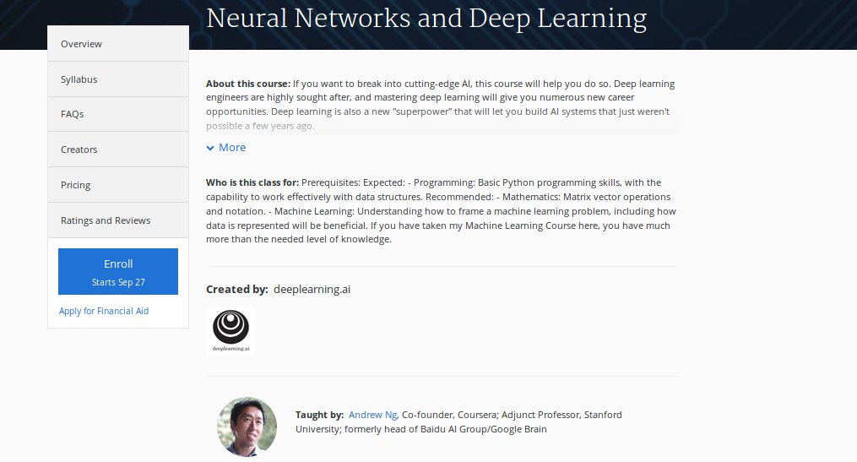
Neural Network and Deep Learning by
Prof. Andrew Ng
https://www.coursera.org/learn/neural-networks-deep-learning

Slide 32
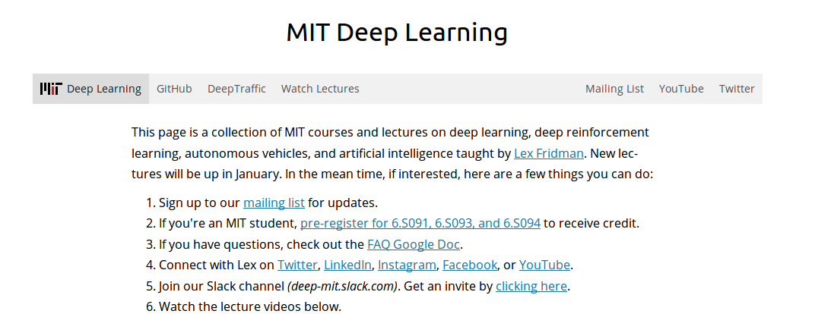
https://deeplearning.mit.edu/
http://introtodeeplearning.com/

Slide 33
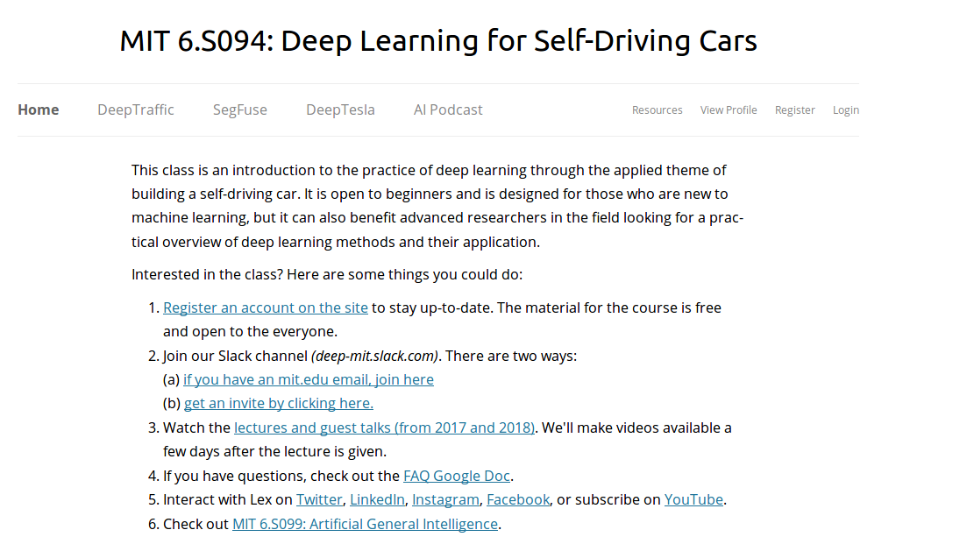
Deep Learning for Self-Driving Cars
https://selfdrivingcars.mit.edu/

Slide 34
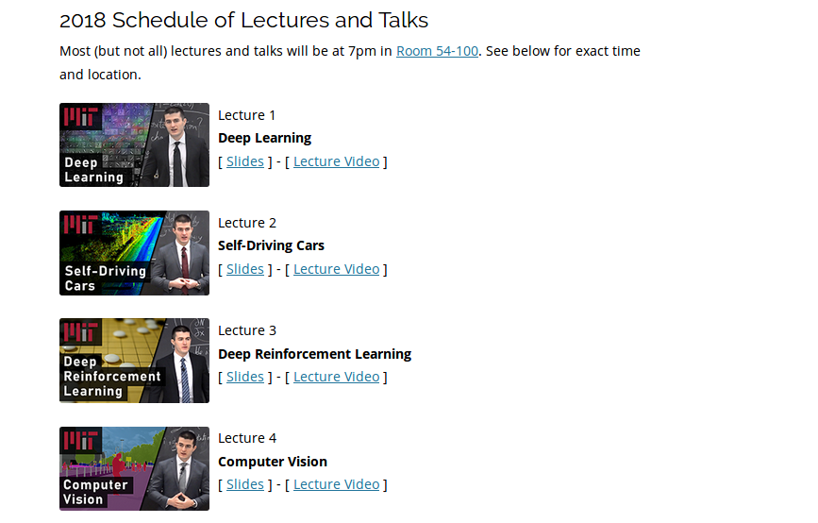
Video lectures from the self driving Car

Slide 35
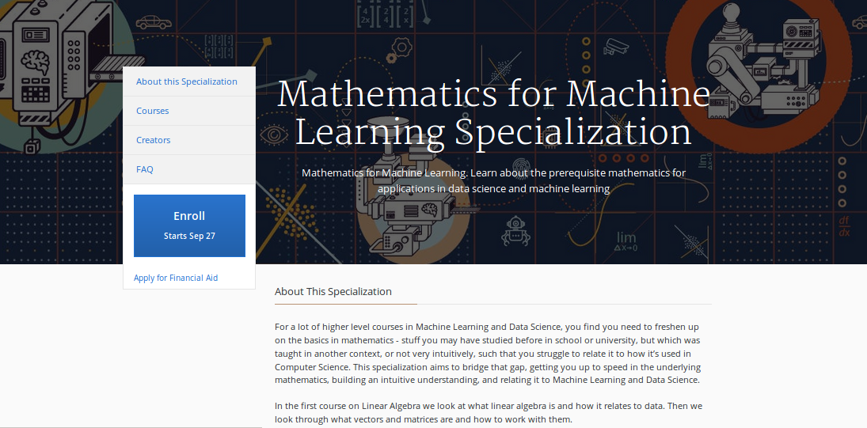
Mathematics for Machine Learning
https://www.coursera.org/specializations/mathematics-machine-learning

Slide 36
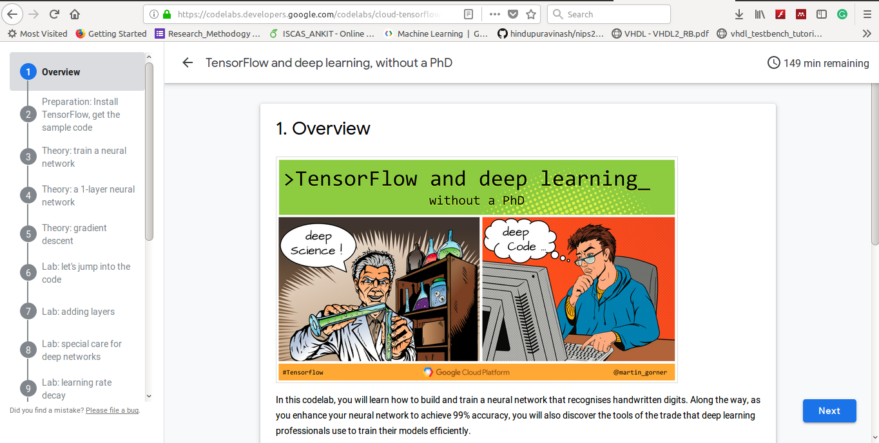
Machine Learning Without Ph.D
https://cloud.google.com/blog/products/gcp/learn-tensorflow-and-deep-learning-without-a-phd

Slide 37
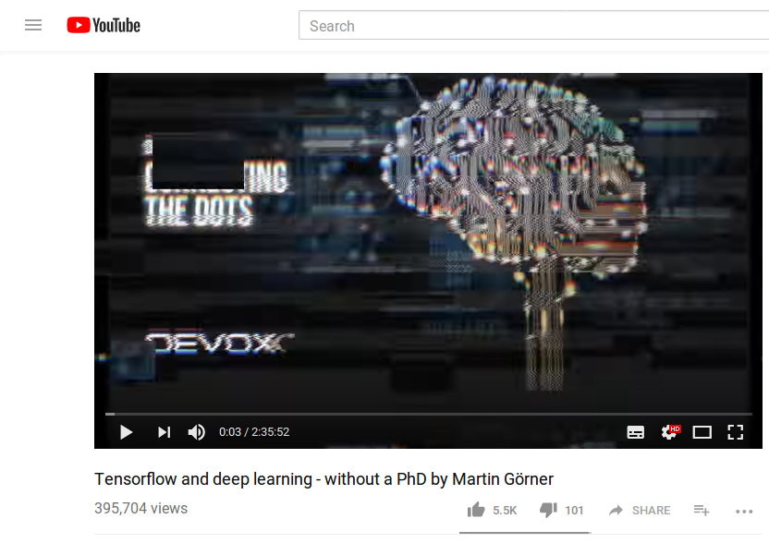
https://www.youtube.com/watch?v=vq2nnJ4g6N0

Slide 38
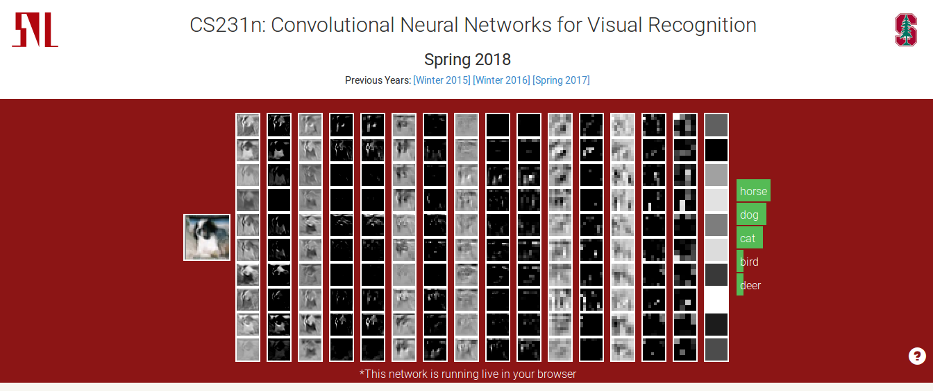
CS231
http://cs231n.stanford.edu/

Slide 39
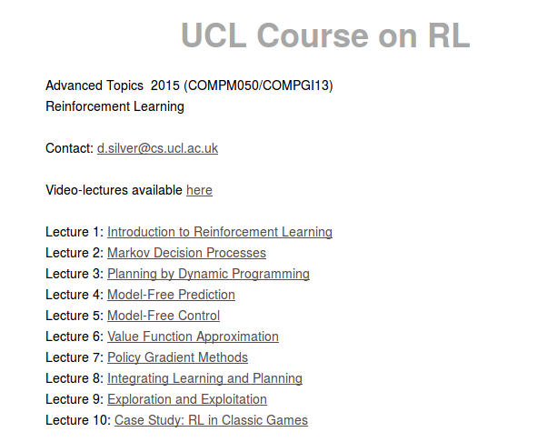
http://www0.cs.ucl.ac.uk/staff/d.silver/web/Teaching.html

Slide 40
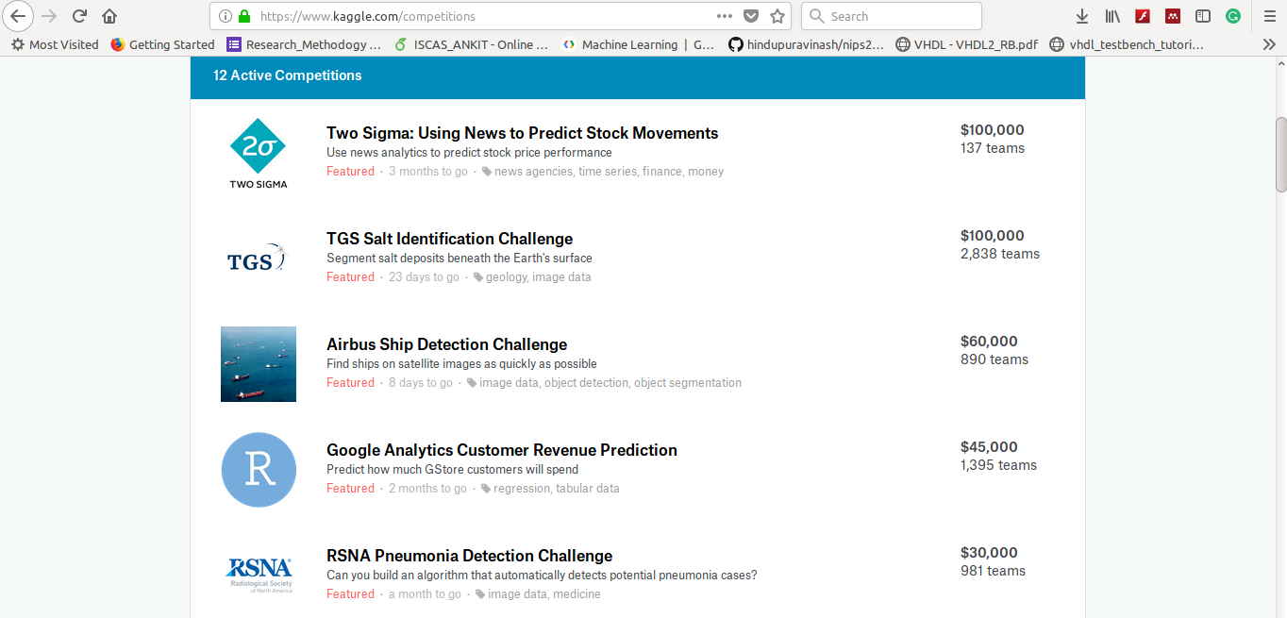
Kaggle.com
https://www.kaggle.com/

Slide 41
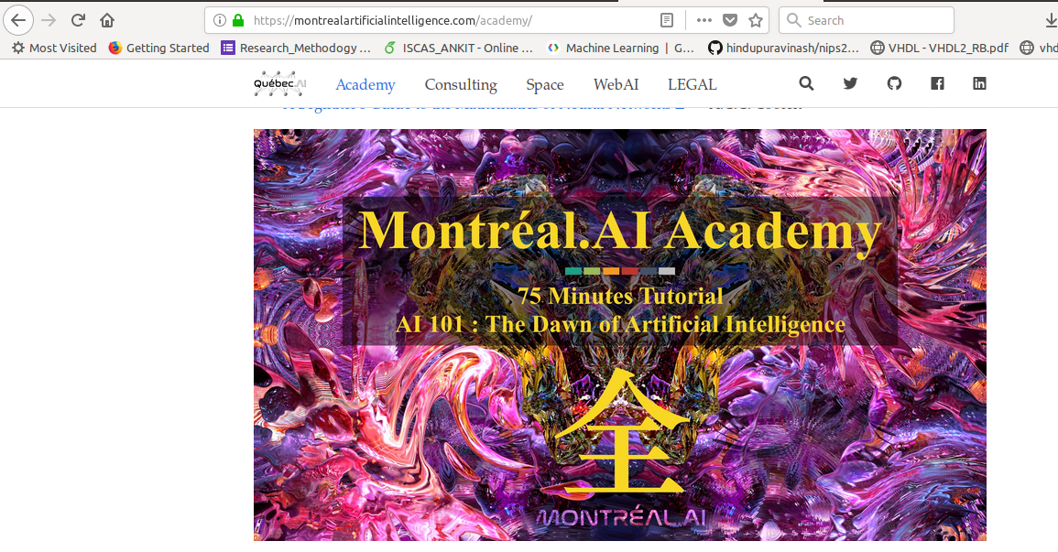
Montreal Academy
https://montrealartificialintelligence.com/academy/

Slide 42
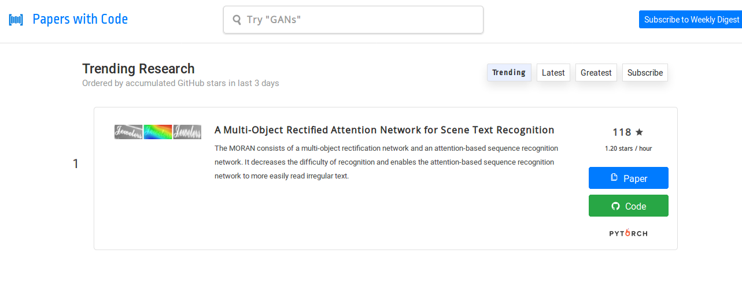
https://paperswithcode.com/

Slide 43
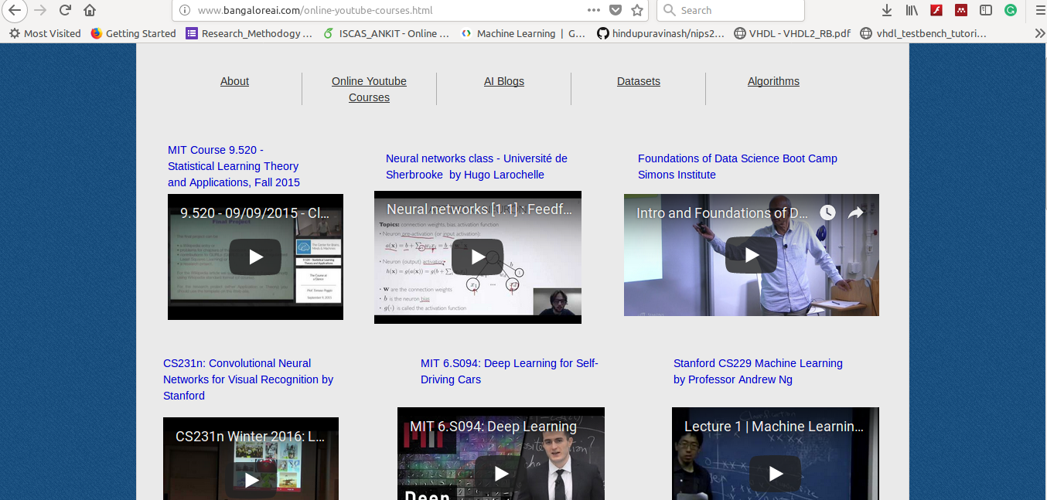
http://www.bangaloreai.com/online-youtube-courses.html

Slide 44
Connect me
Kundankumar@ieee.org
https://in.linkedin.com/in/kundan153
https://www.facebook.com/kundan.space

